Slide 1

Automated Guided Vehicle (AGV) & Autonomous Mobile Robot (AMR)
Amirul Iman bin Kamarudin 1916367

Slide 2

Introduction

Slide 3
Definition of AGV and AMR
AGV - Automated Guided Vehicle
AMR - Autonomous Mobile Robot
Automated guided vehicles (AGVs) are material handling systems or load carriers that travel autonomously throughout a warehouse, distribution center, or manufacturing facility, without an onboard operator or driver.
Autonomous mobile robot (AMR) is any robot that can understand and move through its environment without being overseen directly by an operator or on a fixed predetermined path.

Slide 4

Comparison between AGV and AMR
AGVs require a pre-defined path while AMRs are capable of autonomous navigation

Slide 5

History of AGV/AMR

Slide 6
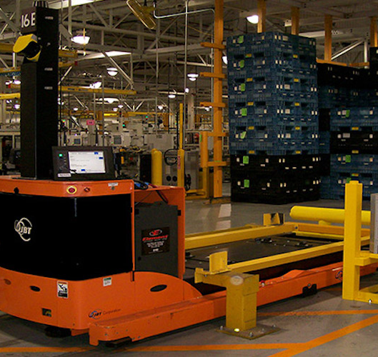
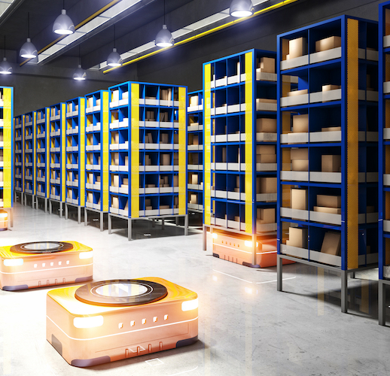
Early development
First AGVs were introduced in the 1950s
The first automated guided vehicle arrived in the early 1950s and was little more than a glorified tow truck, albeit one that did not require a driver or a fixed rail system, navigating instead by following a track of wires embedded in the factory floor that generated a magnetic field.
First AMRs were introduced in the 1970s
Autonomous mobile robots are a significant upgrade from AGVs in many ways, most notably in their ability to navigate dynamic environments, which makes them particularly suited to work as fulfillment robots in an e-commerce warehouse.

Slide 7

Technological advancements
Introduction of sensors and navigation systems
The AMR uses data from cameras and built-in sensors and laser scanners as well as sophisticated software that enables it to detect its surroundings and choose the most efficient route to the target.
Integration of machine learning and artificial intelligence
AMRs offer infrastructure-free, natural navigation and are safe and flexible for collaborative operation. They offer a quick return on investment, machine learning, cloud-based analytics and handle loads in all shapes and sizes: pallets, racks, totes and trolleys.

Slide 8

Applications of AGV/AMR

Slide 9
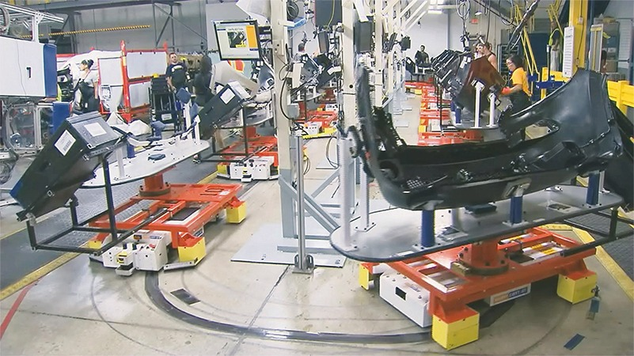
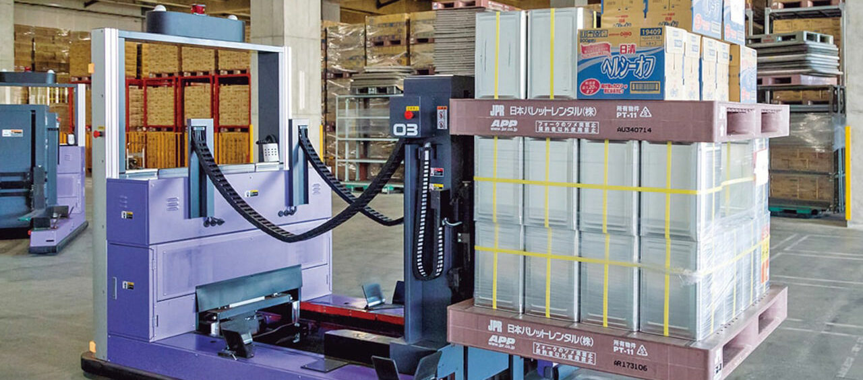
Manufacturing
Material handling
An automated guided vehicle (AGV) is a computer-controlled vehicle used to carry or tow materials in a manufacturing facility. In this video, Bruce Buscher, vice-president of Daifuku’s AGV group, explains why AGVs are a great solution for your assembly line and how you can integrate them with your material handling system.
https://www.flexpipeinc.com/ca_en/why-you-should-use-agvs-on-your-assembly-line/
Assembly line automation
The biggest advantage of using automated guided vehicles on your assembly line is flexibility. Traditional assembly lines are made up of structures such as towline conveyors and overhead conveyors that are permanently attached to the floor, making it difficult to change the configuration of the line after installation.

Slide 10
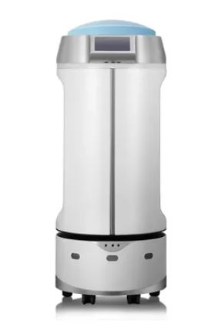
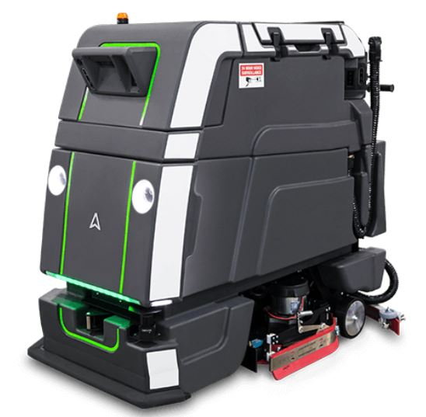
Healthcare
Meals from the kitchen to wards and the return of empty trays to the kitchen.
Waste bins and trolleys. Full and empties management.
Linen transportation (clean and soiled).
Deliver trolleys/carts for cleaning and activate cart-washing systems.
Sterile Supplies Transportation.
Drugs and other supplies in the hospital (wards, theaters, pharmacies, laboratories etc).

Slide 11

Main Components of the Robot

Slide 12
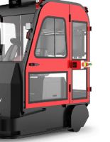
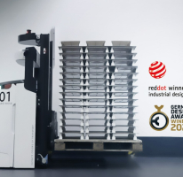
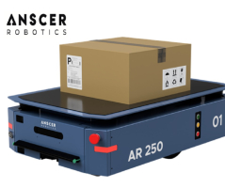
Body Design
1. The Automated Guided Carts (AGCs) or Under Ride robots are mobile platform robots that engage carts underneath them to transport them safely.
2. An AGV Tugger vehicle is a type of automated guided vehicle designed to tow carts or trolleys. Basically, it is a driverless convoy with an AGV locomotive that is an automated tow tractor.
3. Automatic forklifts are complex machines able to perform incredible tasks in warehouses and production facilities. They are fast and accurate, and they improve many material handling operations.

Slide 13
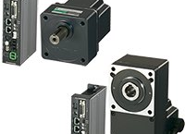
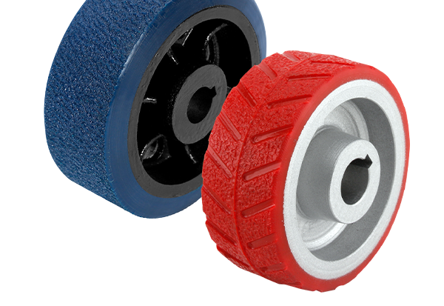
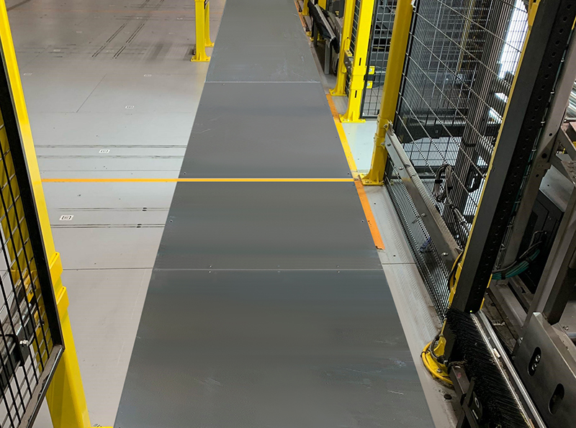
Locomotion
AGV Drive Wheel / AMR Drive Wheel
prevent work failure and accidents of AGV.
Tracks
Used for uneven surfaces
TriGard® is a proprietary finish developed and engineered specifically to endure the consistent, repeated travel patterns associated with AGV and AMR robotic traffic and is designed to withstand 10 years of high-frequency repeat traffic.
The TriGard finish comes standard with electrostatic dissipative (ESD) finish that protects electronic equipment from damage and complies with ANSI/ESD Association specifications.
Motor
Battery Friendly & Better Heat Dissipation
Compact Design
https://www.orientalmotor.com.my/om/technical/brushless-dc-motors/brushless-dc-motors-agv-designs.html

Slide 14
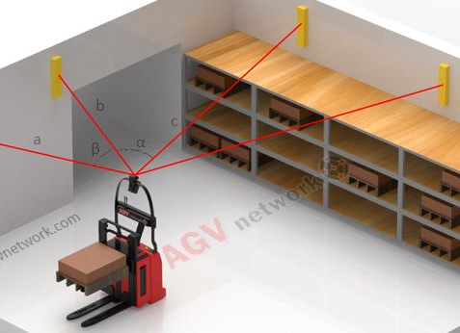
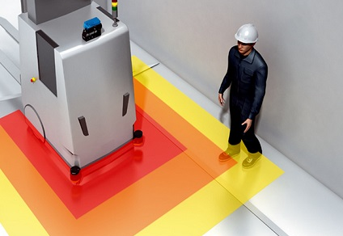
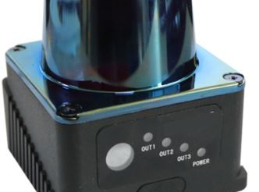
Navigation
1. Sensors
AGV Safety Laser Scanner: Non-Contact Sensors
AGV Safety Lasers scan the surrounding area and slow down or stop the vehicle if they detect an obstacle.
2. Lidar
uses lasers to detect obstacles and create a map of the environment
The 360° horizontal 2D LiDAR detect reflector marks within the working environment, measures the distance away with high precision and provides the on-board computer with precise information about the vehicle's absolute position.
3. Cameras
used for object detection and recognition
4. Ultrasound
used for distance measurement and obstacle detection
5. Infrared
used for object detection and heat mapping
6. SLAM
Simultaneous Localization and Mapping
If the vehicle is unable to localize its position, it is unable to navigate. The vehicle can determine its position on a physical track or with the aid of a map-based localization system (SLAM).
7. GPS
Global Positioning System
8. Odometry
using wheel encoders to track movement

Slide 15
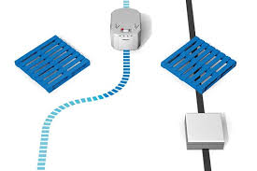
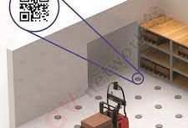
Data Collection
Sensors
- sensor bias, temperature, non-linearity, and misalignment (used for calibration)
RFID readers
-RFIDs offer a reliable identification of concealed or contaminated objects, as no visual contact with the RFID tag is necessary. RFIDs identify large objects with undefined tag positions due to large reading distances (even 1m).
Barcode scanners
-Transported material identification

Slide 16
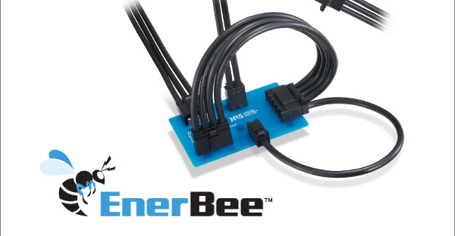
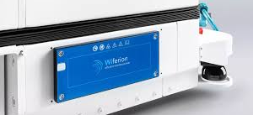
Data Transmission
Wireless Technologies
-Wireless charging for AGV (Automated guided vehicle) is the technology of the future when it comes to power vehicles. In addition to the development of smart algorithms, sophisticated sensor technology and decentralized intelligence in AGVs, right up to swarming behavior, are inductive chargers (wireless charging) the key to making solutions even more powerful and enabling fully automated agv system processes.
Bluetooth
Murata Electronics Type 1DX Wi-Fi® 11b/g/n + BLUETOOTH® 4.2 Module
Wired technologies
The DF60 Series is a 65A Max., wire-to-board connector for internal power supply. The positive lock and 5-point contact design provide high contact reliability. Finger protect type and key variations are also available for safe use.

Slide 17
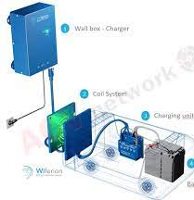
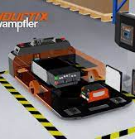
Power Management
Battery systems
Lithium-ion
Nickel-cadmium
Lead-acid
Charging systems
Plug-in chargers
Wireless chargers
Swapping stations

